Slide 1
Technical survey project
권 재은 21511714

Slide 2
CoAP (Constrained Application Protocol)
Protocol created to support Internet communication of constrained
(simple electronic) devices.
It was created for the purpose of controlling devices such as low-power sensors, switches, and valves in a standard Internet environment
Extension
-Blockwise transfer
Transfer block by block to transfer large data.
-Observing resources
Get persistent results
Notes:
abbreviation

Slide 3
CoAP (Constrained Application Protocol)
Pros
-It is designed to interoperate with HTTP and RESTful web through a simple proxy, making it
essentially suitable for the Internet.
-CoAP runs UDP, which is less reliable than TCP, and relies on repetitive messaging instead of
consistent connections to provide reliability. UDP's connectionless datagrams allow for less
overhead, smaller packets, and faster wake-up and transmission cycles.
This allows the device to remain dormant for longer periods of time, saving battery power.
Cons
-It is difficult to use in a NAT environment because it uses only UDP packets, and can only be
used by tunneling or port forwarding.
-Although it can discover and observe resources, it is not suitable for event-based data
communication.

Slide 4
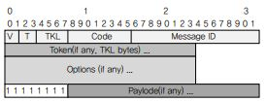
CoAP (Constrained Application Protocol)
Frame composition
-CoAP messages are encoded in a simple binary format as shown in the figure. The message
contains a fixed 4-byte header. Subsequently, a token of length 0 to 8 bytes is placed.
Then comes the options. If there is a payload, it is placed from the next to the end of the
datagram.

Slide 5
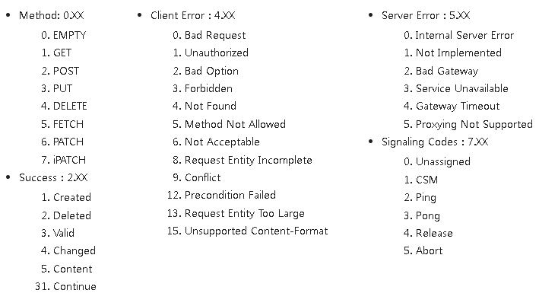
CoAP (Constrained Application Protocol)
-The header includes V (version) / T (message type)/ TKL (token length) / Code / message ID
-In the code, 3 bits mean class, and 5 bits represent details. In the CoAP document, it is expressed as c.dd.

Slide 6
MQTT (Message Queuing Telemetry Transport)
Publish-subscribe based messaging protocol.
It is a “many-to-many” communication protocol that delivers messages between multiple clients
through a central broker.
Operates over TCP/IP protocol and is designed for connectivity to remote locations that require a
"small code footprint" or have limited network bandwidth.
QoS(Quality of Service)
-There are 0, 1, and 2 levels, and it indicates the level at which the message delivery guarantee is
increased.

Slide 7
MQTT (Message Queuing Telemetry Transport)
QoS 0
-It is called 'Fire and forget', and it does not guarantee the arrival of a message because it only
takes one transmission. It can be used for very repetitive message types or non-business critical
messages.
QoS 1
-Ensure that the message is received at least once by the intended recipient. When the issued message is received and understood by the intended recipient, the receipt of the message is confirmed via a confirmation message (PUBACK) sent to the issuing node. Messages are stored and resent regularly until the issuer receives a PUBACK. This kind of message can be useful for non-critical node shutdown.
QoS 2
-Ensure that messages are received and decrypted by the intended recipient. This step is the most secure and reliable MQTT QoS step. The issuer sends a message indicating that it has a QoS 2
message. The intended recipient collects the notification, decrypts it, and indicates that It is ready to receive the message. The publisher relays the message. When the destination understands the message, it uses the acknowledgment to complete the transaction. These kinds of messages can
be used to turn lights or alarms on or off in your home.

Slide 8
MQTT (Message Queuing Telemetry Transport)
Pros
-MQTT is basically characterized by reliability and low power, so it is
suitable for application to IoT networks.
-Advantages of Publish/Subscribe Model
1) Separation of space
2) Time separation
3) Synchronization separation
-LWT: MQTT provides a 'LWT (last will and testament)' message that can be saved to the MQTT broker in case a node unexpectedly loses its connection from the network.
-It can be organized hierarchically using forward slashes (/), so you can
efficiently manage a large number of sensor devices.

Slide 9
MQTT (Message Queuing Telemetry Transport)
Cons
-Using a central broker can be a disadvantage for IoT systems in a decentralized environment.
In the case of a system with a central broker, when the system is expanded, the network expands
naturally and a central broker is required. No individual node wants to assume the cost and
responsibility of requiring resources, software and complexity that are not critical to the final node function. The central broker can be a single point of failure in a complete network.
-TCP was originally designed for devices with a lot of memory and processing resources.
Therefore, it is not suitable for use in a lightweight IoT type network. The TCP protocol must
establish a connection through a multi-step handshake process before exchanging messages.
This method increases the wake-up time and communication time, and shortens the battery life in the long term.

Slide 10
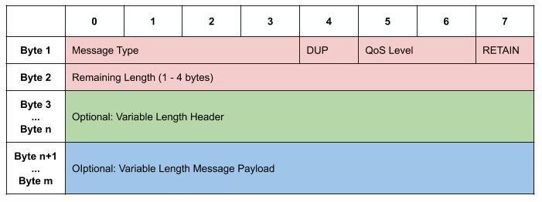
MQTT (Message Queuing Telemetry Transport)
Message format

Slide 11
MQTT (Message Queuing Telemetry Transport)
Message type
Reserved 0 Reserved
CONNECT 1 Client request to connect to Server
CONNACK 2 Connect Acknowledgment
PUBLISH 3 Publish message
PUBACK 4 Publish Acknoledgment
PUBREC 5 Publish Received (part 1)
PUBREL 6 Publish Received (part 2)
PUBCOMP 7 Publish Complete (part 3)
SUBSCRIBE 8 Client Subscribe request
SUBACK 9 Subscribe Acknoledgment
UNSUBSCRIBE 10 Unsubscribe Acknoledgment
UNSUBACK 11 Unsubscribe Acknoledgment
PINGREQ 12 PING Request
PINGRESP 13 PING Response
DISCONNECT 14 Client is Disconnecting
Reserved 15 Reserved

Slide 12
XMPP (Extensible Messaging and Presence Protocol)
TCP communication protocol based on XML
Although this protocol is well known as an instant messaging protocol, it is also used as a general messaging service.
XMPP architecture
1) Server: Represented by host name or IP by DNS.
2) Client: Have an account using the server and host name and ID.
3) Gateway: Connected to a specific server like a client and connected to another network or IM protocol of another protocol through a gateway

Slide 13
XMPP (Extensible Messaging and Presence Protocol)
Pros
-The XMPP server can be separated from the public XMPP network, and
strong security can be added to the XMPP standard.
-XMPP works similar to email. Rather than relying on a single central server or broker like CoAP or MQTT, it works across multiple transfer agents. Also, since anyone can operate the server, the company intranet uses built-in TLS encryption when security is required. Can be isolated using a secure authentication protocol.
-Open standards: Because it is an open standard, you can freely use it, and there are many
libraries to use, so it is easy to implement a necessary client.
-Extensible: XMPP is an XML-based protocol, and since it is easy to extend the messaging protocol itself, it is easy to build a custom application based on XMPP messaging.

Slide 14
XMPP (Extensible Messaging and Presence Protocol)
Cons
-No end-to-end encryption.
-weak at Binary Data transferring: To exchange binary data in the current XMPP, it must be base 64 encoded and attached to a single XML.
Therefore, there is a disadvantage of inefficiency in data exchange.
-There is no QoS (Quality of Service). Ensuring that the message is delivered is important when
sending instant messages, but even more important in IoT.

